Slide 1
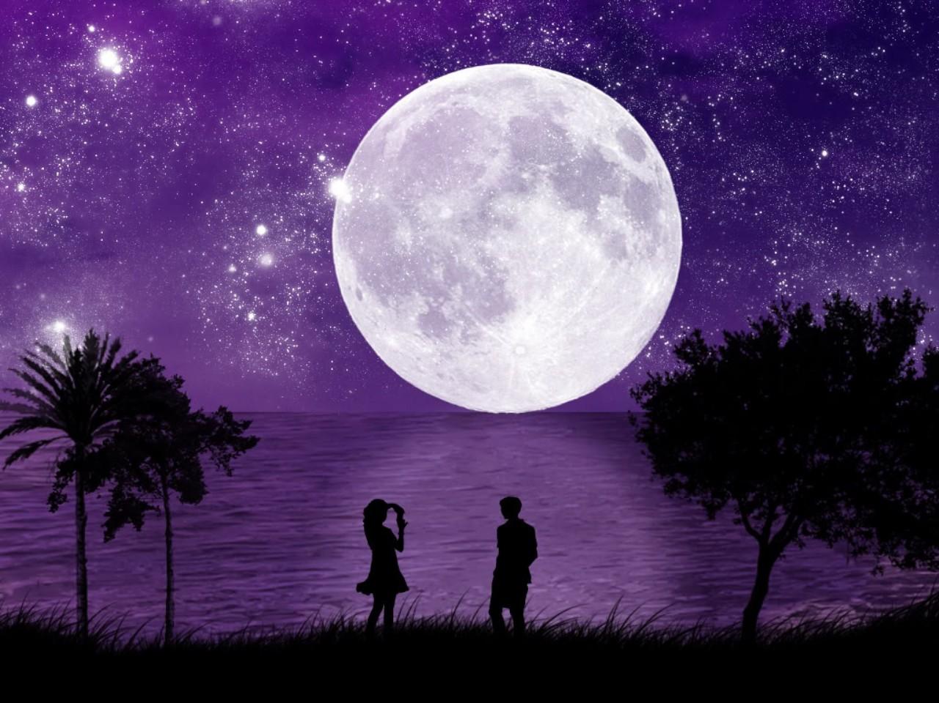
Punctuation By Torin, Shelby, Keonte,
Can’t live without it

Slide 2
The Comma
-Use commas to separate three or more words, phrases, or clauses in a series-
-Example-
We had lunch with Grandma. We ate chicken, mash potatoes, and green beans.
-no commas are necessary when all of the items are connected by conjunctions.-
-Use commas between the main clauses in a compound sentence. Place a comma before a coordinating conjunction (and, but, or, nor, yet, or -for)
-Example-
I would go to the mall, but I am far to busy.
-Place a comma between coordinate adjectives that precede a noun-
-Example-
I’ve never noticed how much of a fun, easy, and informative class this is.
-you may omit the comma between very short main clauses that are connected by a coordinating conjunction unless the comma is need to avoid confusion.
1)We visited Miami , and the everglades are next. (clear)
2)We visited Miami and the everglades are next.(confusing)

Slide 3
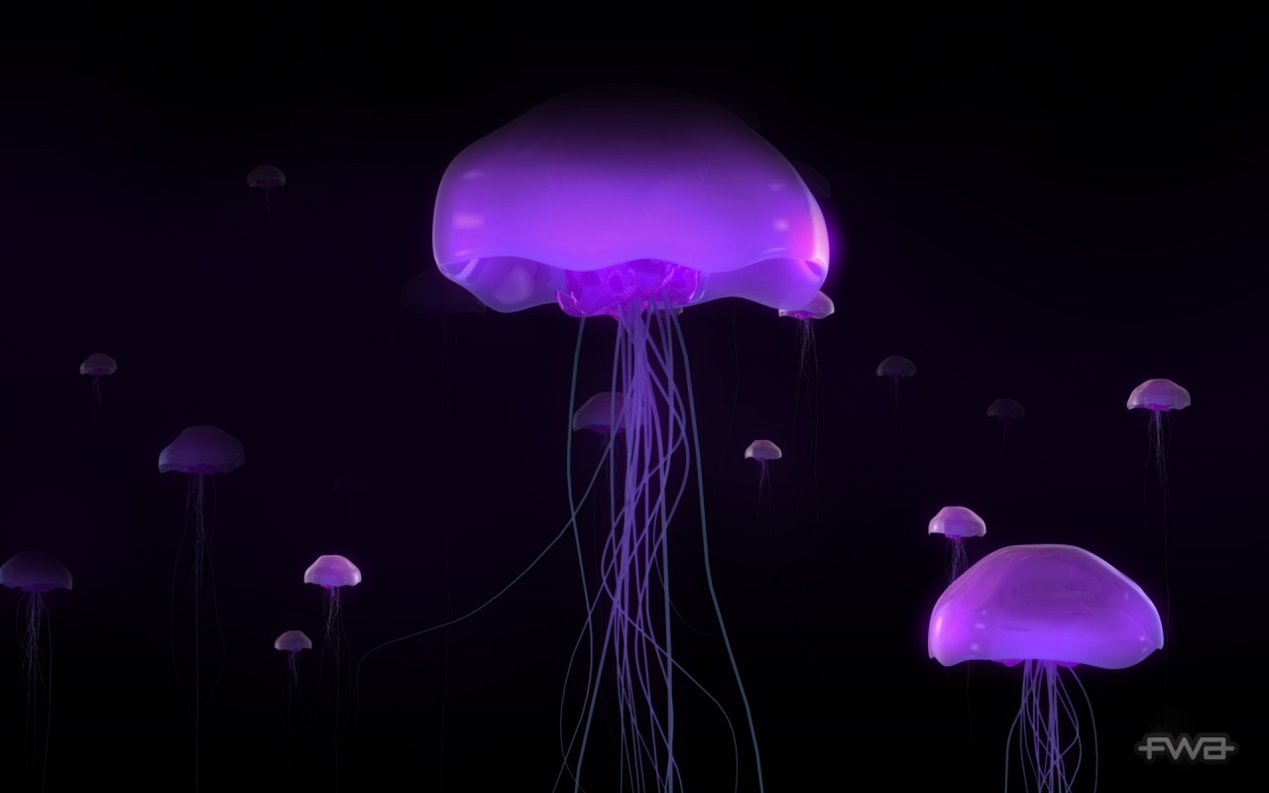
Fill in the missing commas
1) I love sports but I do not understand them as well as other might.
2) I love all animals. I love cats dogs and even wild animals.
3) I know my birthday May 21 1998 but I do not know yours.
4) For the slumber party I’ll take my sleeping bag toothbrush and PJs but tomorrow I’ll bring my tent so we can sleep out side.

Slide 4
Semicolon
-use semicolons to separate main clauses that are not joined by a coordinating conjunction (and, but, or, nor, yet, and for)-
-In general, a conjunctive adverb or an expression such as for example is followed by a comma-
-Example-
France is a beautiful tourist attraction know for it’s divine food; it’s also known for being the most romantic country.
-use semicolons to separate main clauses joined by a conjunctive adverb (such as, however, therefore, nevertheless, moreover, further more, and subsequently) or by an expression such as for example-
-Example-
Jonhny Depp appeared in many films; such as Pirates of the Caribbean, Edward Scissor Hands, Alice in Wonder land, and many more.
-use semicolons to separate the items in a series when the items contain commas-
-Example-
The Kushites, like the ancient Egyptians they conquered, worshipped Ra; the god of sky; Iris, the great mother goddess and Horus the god of the underworld.
-semicolons are used so the comma and is not over used in a sentence-

Slide 5
Fill in missing semicolons
1) In early times , Kush was famous for its ebony, ivory, gold, silver, incense, wood, and Horus, the son of Osiris.
2) Robeson appeared in many plays and musicals for example, he starred in Othello and Porgy and Bess.
3) For our vacation we went to Sea World in Orlando Florida to our relatives they live in Kentucky and lastly Six Flags also in Kentucky.
4) I think we should order Dominos that good pizza place however the burger place is less expensive

Slide 6
Colon
-Use the colon to introduce a list, use words such as the following, or as follows-
-do not use a colon to introduce a list if the list immediately follows a verb or a preposition-
-examples-
The science test will have the following: cell cycle, osmosis, and mitosis.
-Use a colon to introduce material that illustrates or explains the preceding material-
-examples-
I often wish that my parents had had more than one child: They worry to much about me
-Use a colon to introduce a long or formal quotation-
-A formal quotation is often preceded by such words as these, the following, or as follow-

Slide 7
Other uses of colons
-use a colon for time, and in bible references, and after the salutation of a business letter-
-Examples-
1)12:30 a.m
2)Genesis 7:20-24
3)Sir:
4)4:00 p.m
5)Dear mom:

Slide 8
Fill in missing colons
1) Mrs. Hopkins asked us to write an essay on the following African saying “It is the rainy season that gives wealth”
2)Dear Lindsey I can’t wait until we see each other this summer. I wonder what time it is where you live right now, It’s 5 30 here.
3)I took the liberty of make a shopping list. We will need to buy these things milk, eggs, and bacon.
4)In 2009 a new research was formed for life on Mars even though many people believe its impossible.

Slide 9
The End
☺

